Slide 1
Management Bootcamp
M Iqbal Aula Ramlan
M Ilham Habibie

Slide 2
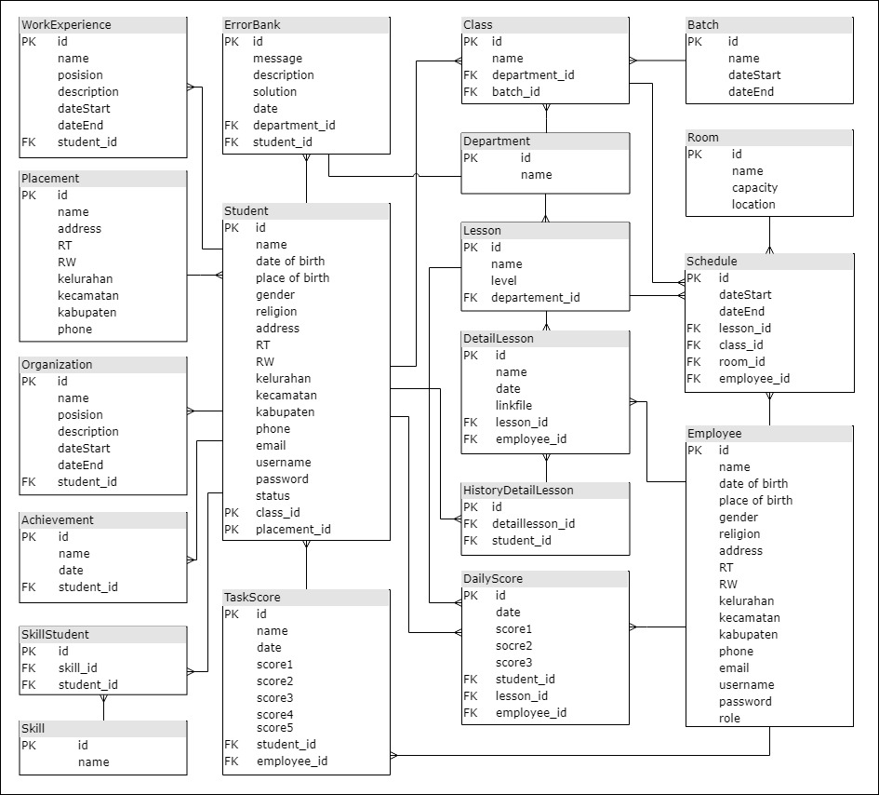
ER Diagram

Slide 3
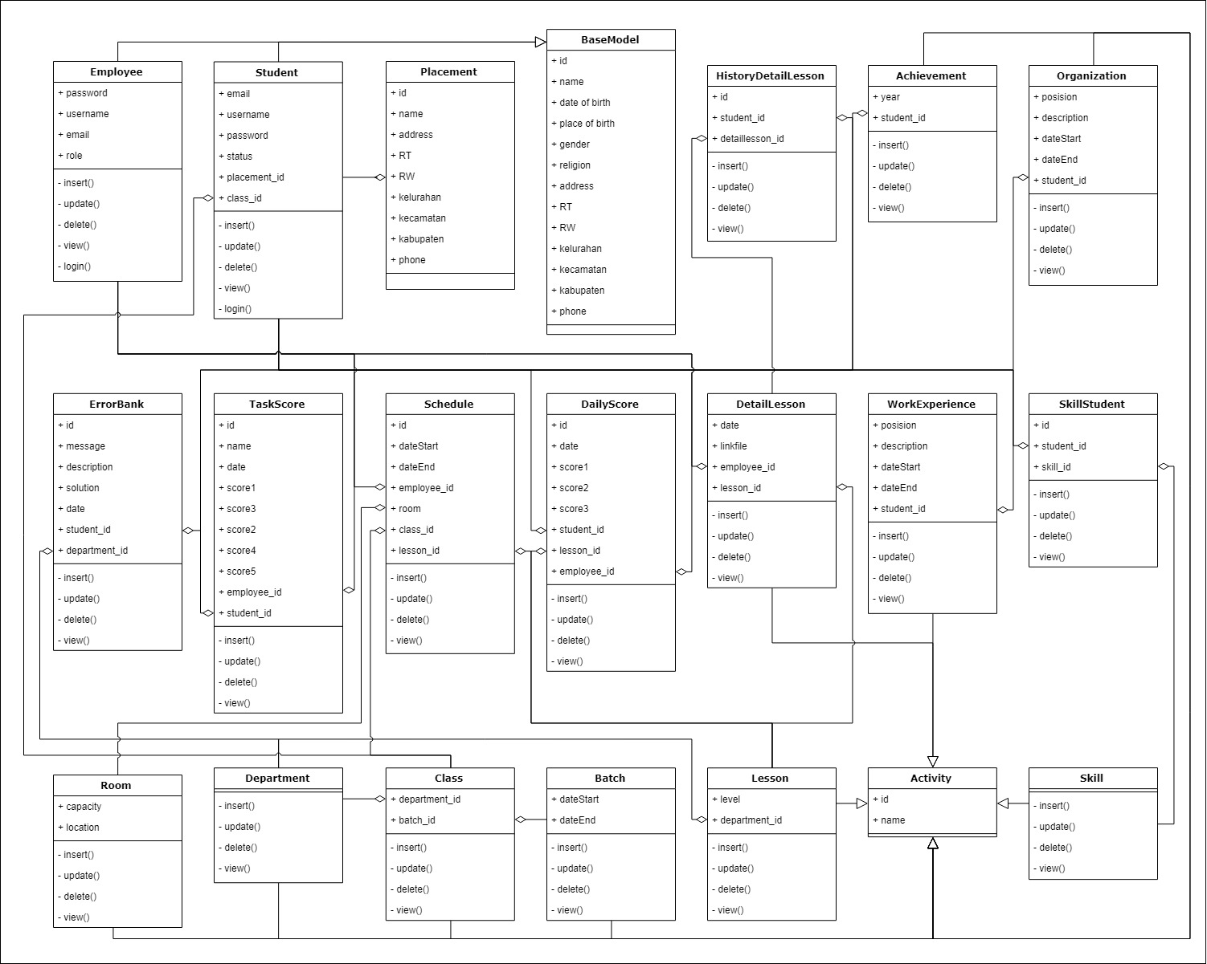
Class Diagram

Slide 4
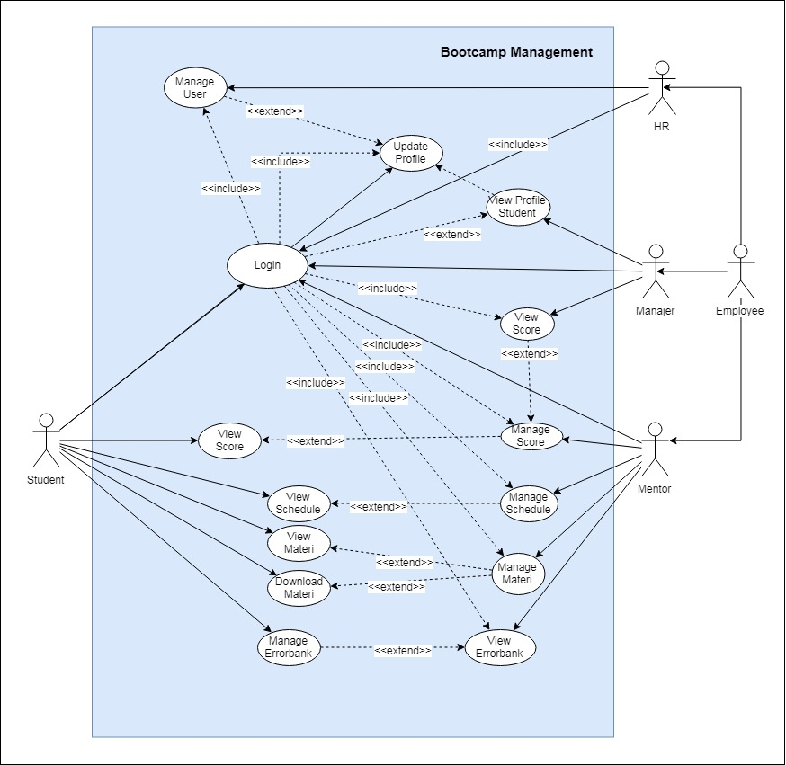
Use Case Diagram

Slide 5
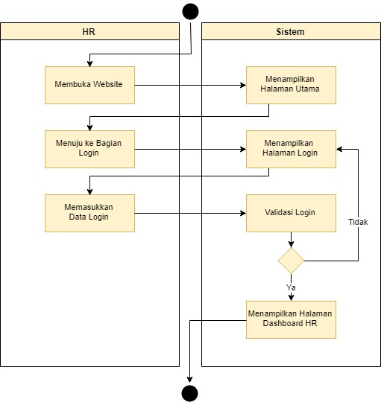
Activity Diagram HR - Login

Slide 6
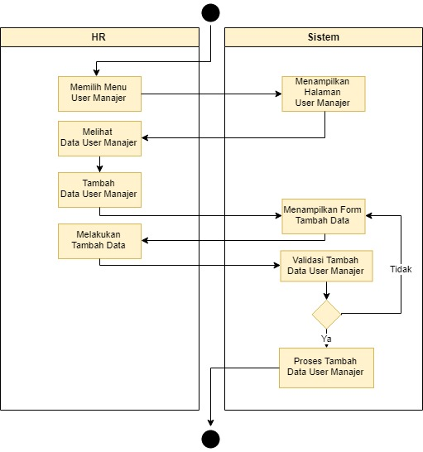
Activity Diagram HR – Add Manager

Slide 7
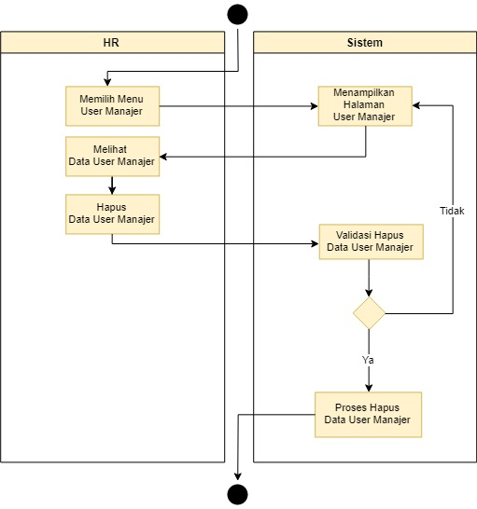
Activity Diagram HR – Delete Manager

Slide 8
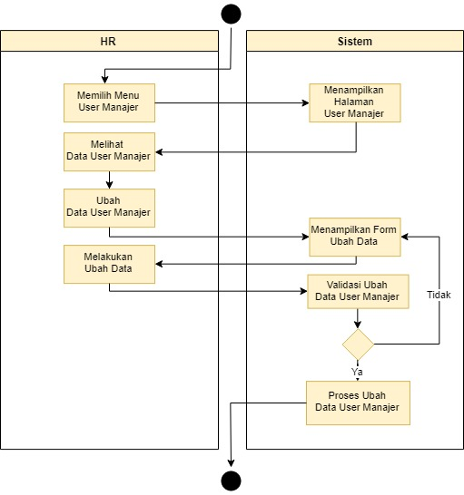
Activity Diagram HR – Update Manager

Slide 9

Activity Diagram HR – Add Mentor

Slide 10
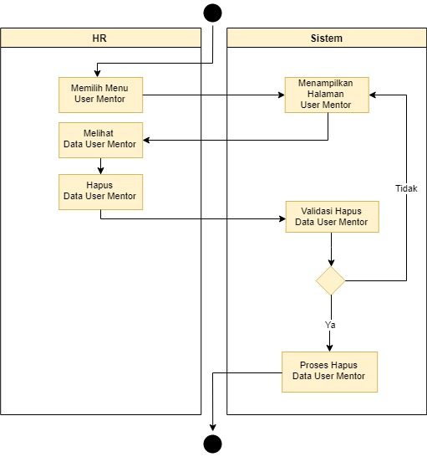
Activity Diagram HR – Delete Mentor

Slide 11
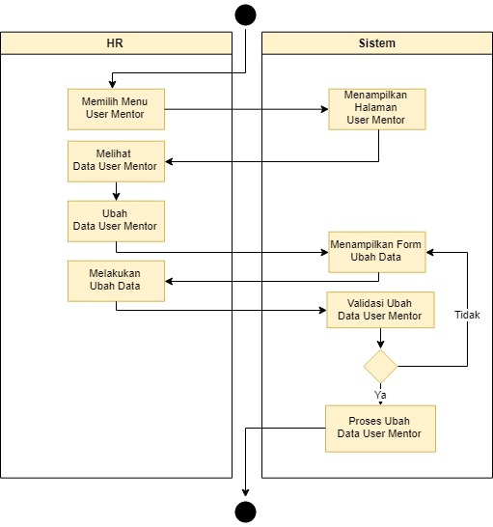
Activity Diagram HR – Update Mentor

Slide 12
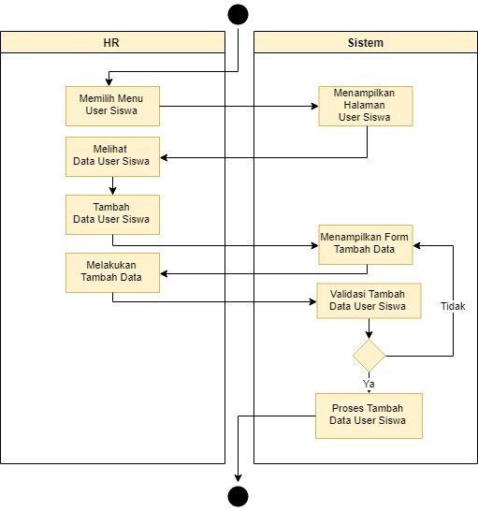
Activity Diagram HR – Add Student

Slide 13
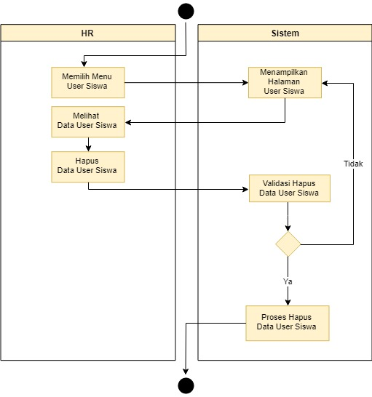
Activity Diagram HR – Delete Student

Slide 14

Activity Diagram HR – Update Student

Slide 15
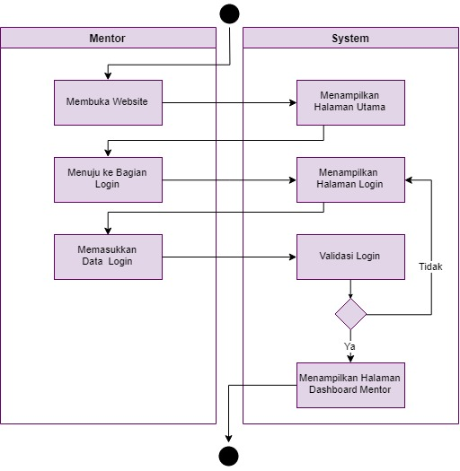
Activity Diagram Mentor – Login

Slide 16
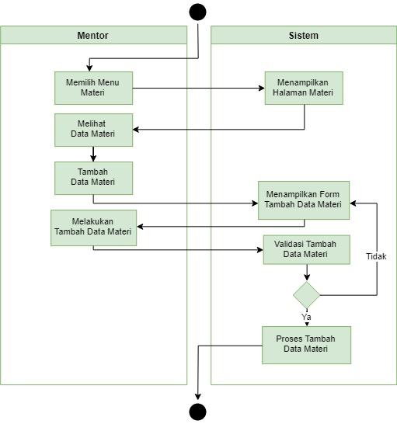
Activity Diagram Mentor – Add Lesson

Slide 17
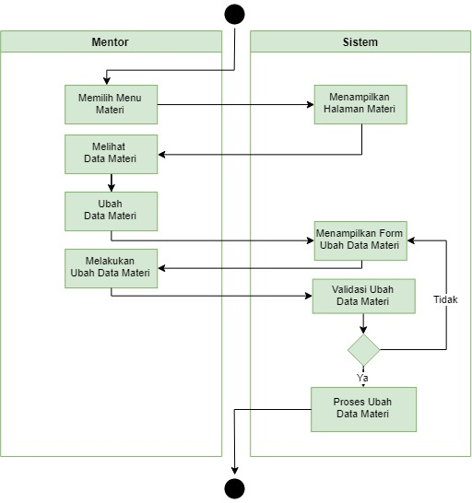
Activity Diagram Mentor – Update Lesson

Slide 18
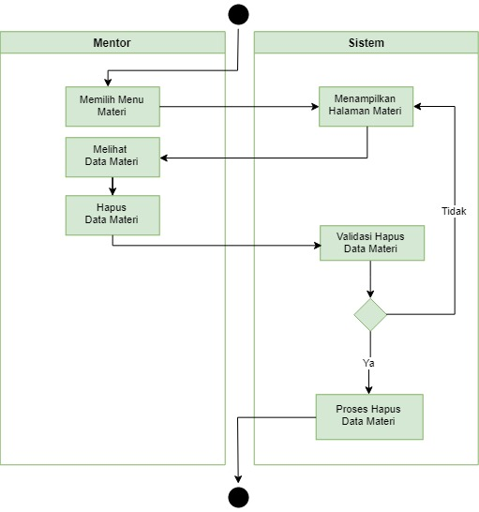
Activity Diagram Mentor – Delete Lesson

Slide 19
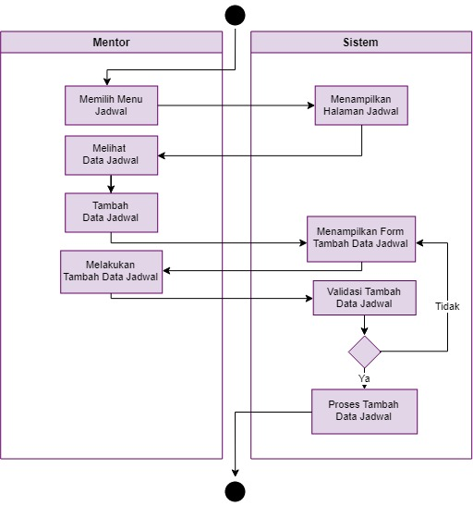
Activity Diagram Mentor – Add Schedule

Slide 20
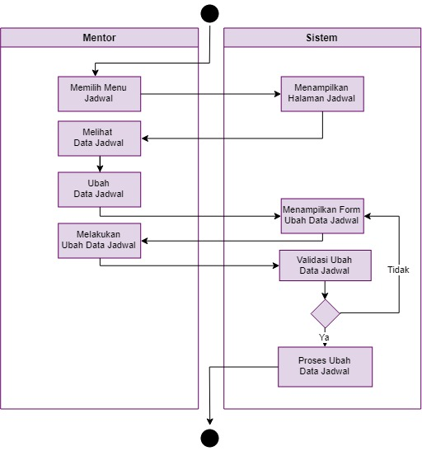
Activity Diagram Mentor – Update Schedule

Slide 21
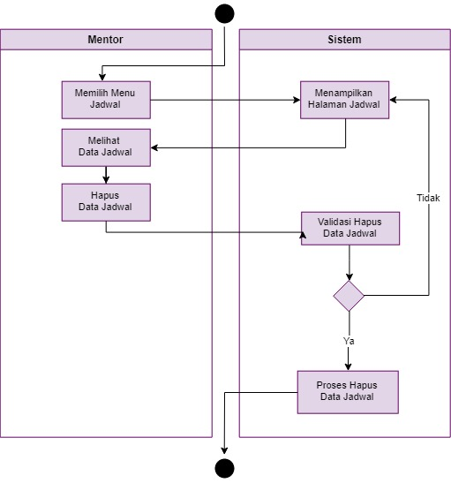
Activity Diagram Mentor – Delete Schedule

Slide 22
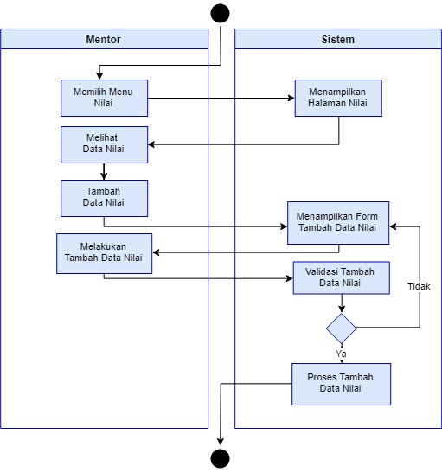
Activity Diagram Mentor – Add Score

Slide 23
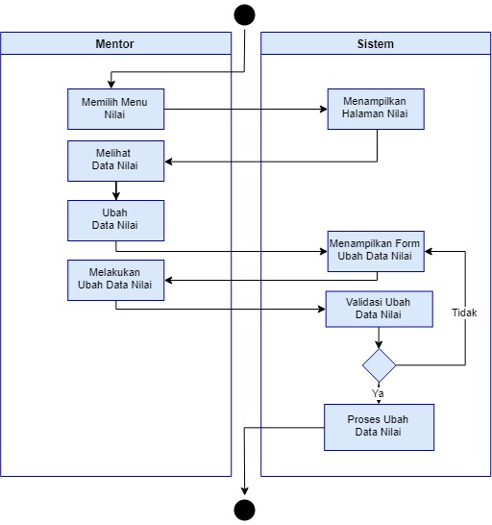
Activity Diagram Mentor – Update Score

Slide 24
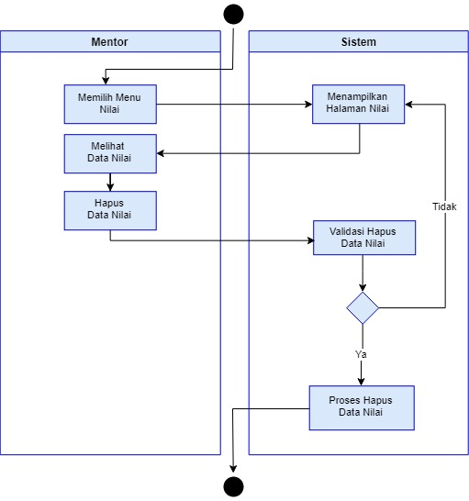
Activity Diagram Mentor – Delete Score

Slide 25
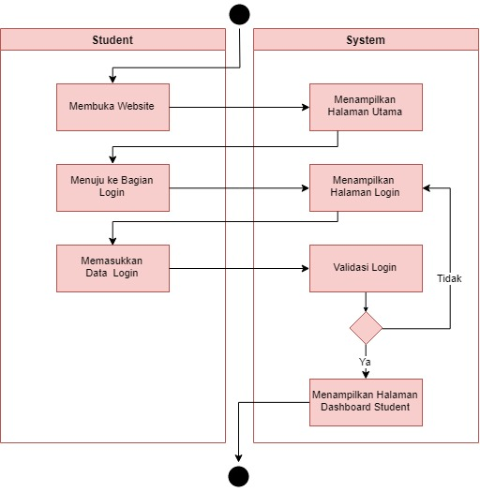
Activity Diagram Student – Login

Slide 26
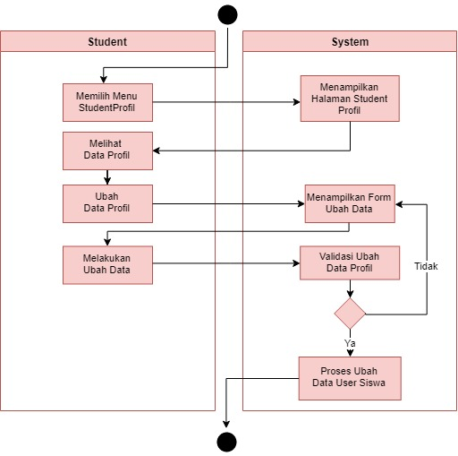
Activity Diagram Student – Update Profile

Slide 27
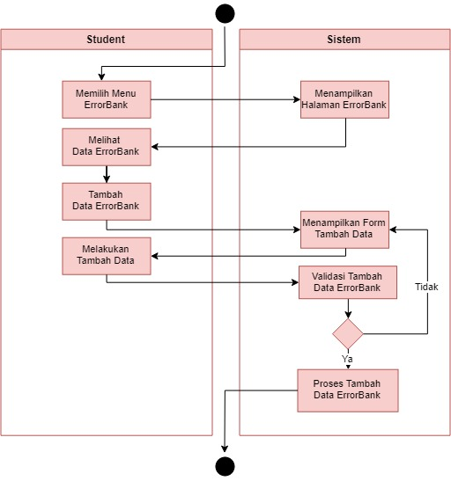
Activity Diagram Student – Add Error Bank

Slide 28

Activity Diagram Student – Update Error Bank

Slide 29
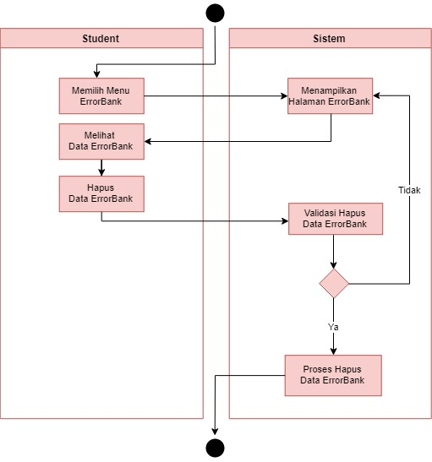
Activity Diagram Student – Delete Error Bank

Slide 30
Activity Diagram Student – Delete Error Bank

Slide 31
Bootcamp Management App

Slide 32
Thankyou.. Any question or suggestion?

